Slide 1
Krab Killer
N315 – Project Three
Jake Terry https://github.com/jaketerry28/CS315-Game-Programming/tree/main/final-project
https://jaketerry28.itch.io/krab-killer

Slide 2
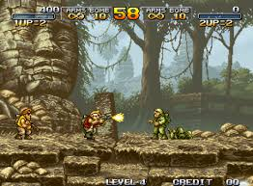
Discussion 0
Inspiration from Metal Slug

Slide 3
Discussion 0.1
Review some game sites on itch.io
Make your own itch account
Create a page for your game – you can keep it private for now
Think about the graphics, text, and decorations you will need on your itch page

Slide 4
Discussion 0.2
Talk with a peer about the following, delete and add a summary of your reflection:
Core gameplay systems
How those systems are interaction loops
What kinds of feedback are needed for players to understand the systems
Visual ( animation, particles )
Audio
Haptic
Look for 1-2 extra learning resources for your game

Slide 5
Discussion 0.3
https://github.com/jaketerry28/CS315-Game-Programming/tree/main/final-project

Slide 6
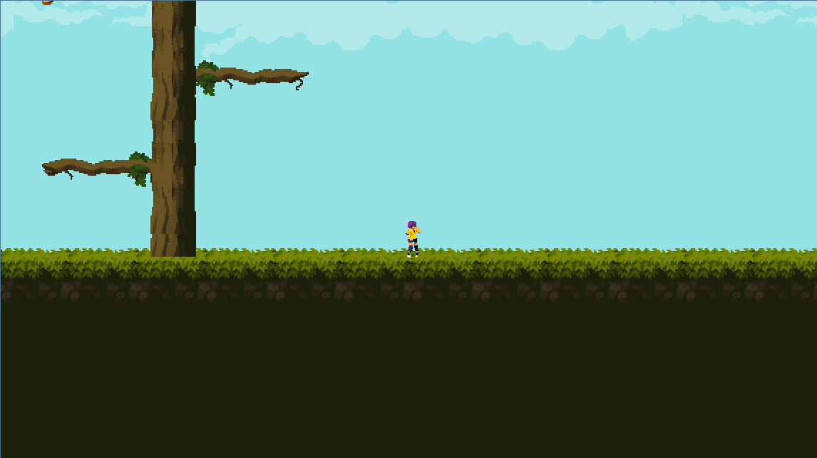
Discussion 1

Slide 7
Discussion 1 – Progress
By now you should have:
Basic interactions programmed (movement, selection.. Whatever)
Basic program structure implemented
Some placeholder assets in the game

Slide 8
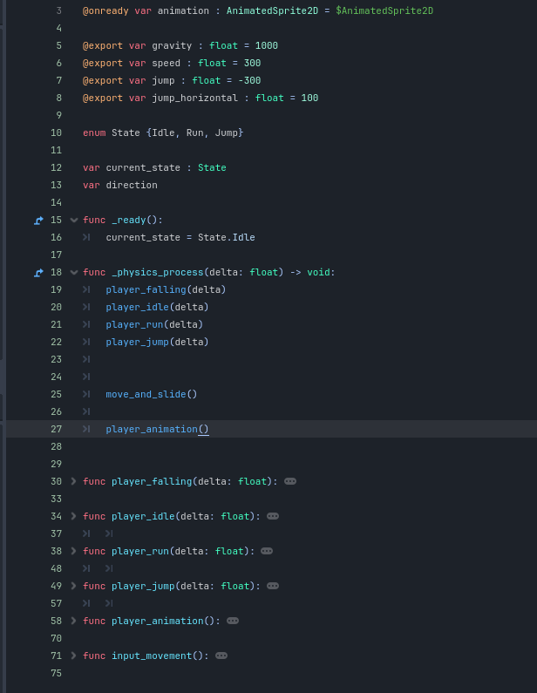
Discussion 1 – Screenshot / image
Focusing on organization and clean code.
Utilizing State to control animations. Initiate state in player_xxxx and play animation through animation_player()

Slide 9
Discussion 1 – Question about your game
Soooo, I am always so bold in what I want to make until I feel limited by animations. This pack has a good run and shoot animation but they are in individual png files. My question is how can I create a sprite sheet from these png files to use in the game?
Another question I have is how I want to make the player able to jump onto the branches on the tree. If the player enters from below, they should be able to pass through and land on the branch. Then if they press down + jump or something, they can fall thru. How do I set up my collision boxes to allow this?

Slide 10
Discussion 1 –Aesthetics & Meaning
Delete this and add 2-3 takeaways from your discussion with your peer
I use an enum State machine to track which state the player character is in.
The jumping animation relies on the jump height to smoothly play its animation without ending prematurely or playing again. I need to fine tune the frame animation and jump velocity to match.
Sound effects and additional animations can add better feedback to the players.

Slide 11
Discussion 1 – Meaning Reflection
I have been more mindful about keeping organization in mind and if there is any repeating code, might as well make it into reusable function. This has been an ongoing theme in all my projects, even the ones outside of class, because once you have to refactor, if you did not keep these things in mind it becomes a pain in the ass.

Slide 12
Discussion 2 –Aesthetics and Meaning

Slide 13
Discussion 2 – Progress
By now you should have
Interactable / extended systems coded
Bugs in implementation
A playable game loop with end state

Slide 14
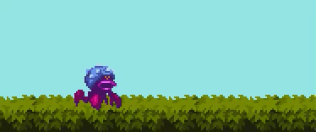
Discussion 2 – Screenshot / Image

Slide 15
Discussion 2 –Question about your game
How do I set a double jump? How can I get enemies to patrol?
IDK WHY MY TUTORIAL TRANSITION WONT WORK??

Slide 16
Discussion 2
Discuss and reflect upon these aspects of your game with a peer
Purpose
Sincerity
Expressiveness
How might important features of the loop be emphasized?
The loop gives players a reason to keep playing the game. Feedback is always helpful to reinforce a good loop.
The bugs are endless and theres always some weird interaction you can learn from. For example, when I got my enemies to patrol, I experienced a weird bug where I I placed the patrol routes incorrectly, then the game would crash.

Slide 17
Discussion 2 –Reflection
A meaningful game to me is one that is impactful and will be remembered by your players. Games are great for developmental stages and a lot of people today have fond memories of great games from their childhood that impacted them and helped shape who they are today.

Slide 18
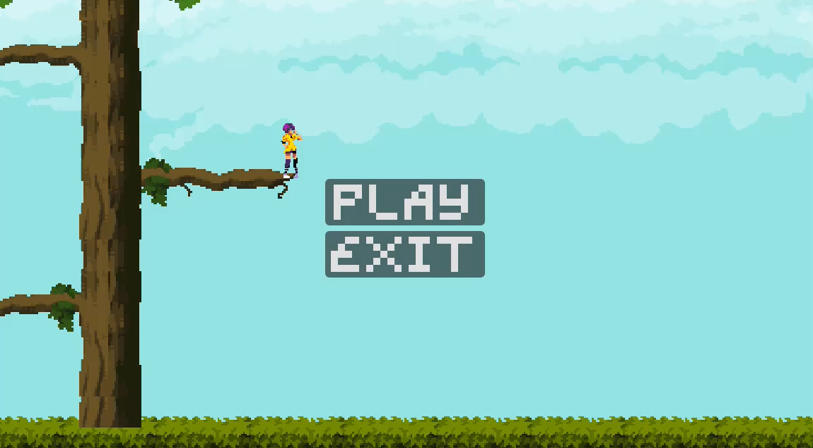
P3 – Final Reflection

Slide 19
P3 – Final Reflection
That theres about a billion ways to skin a cat, none of them are the best, and its worth knowing how you like to skin it and stick to that. I bounced around with how I wanted to organize this and it got messy.
Also I have been learning Strudel and want to use it to make music for my game. The cave level and the tutorial level have music I made on my own with this program.

